Slide 1
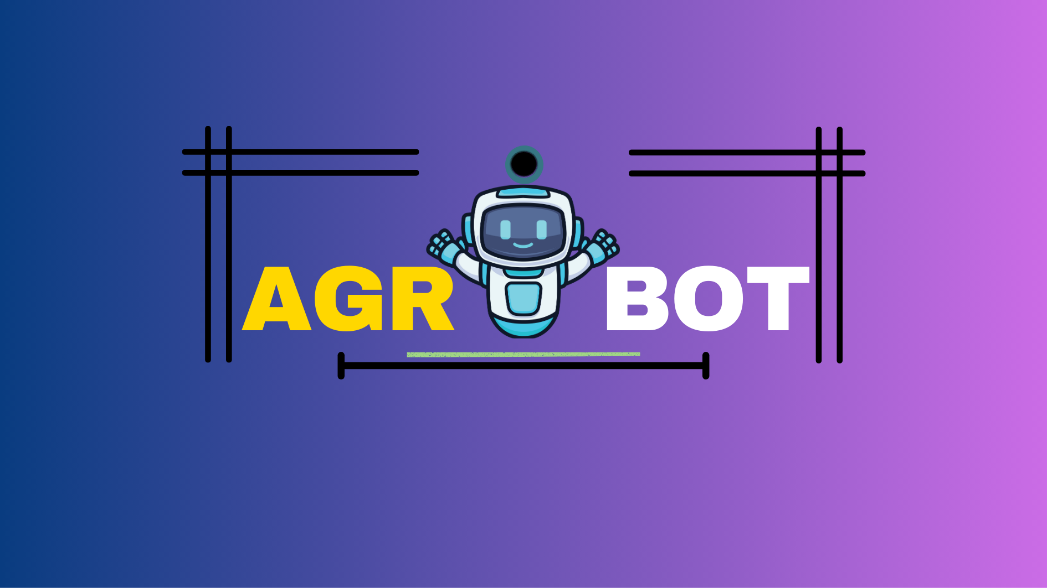
Smarter Farming. Instant Answers, Expert Advice, Anytime, Anywhere!" 🚀🌾

Slide 2


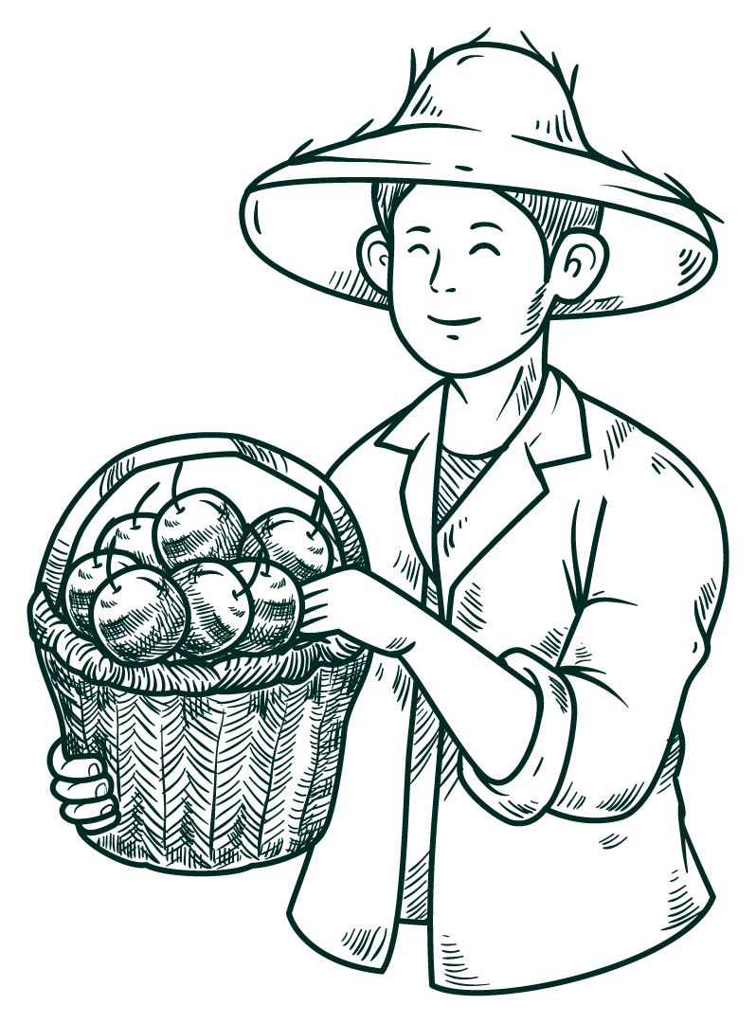



🌾 Agri Bot🌾 YOur AI-powered farming buddy.
Team Name: ERROR404
Theme: Agri-Tech

Slide 3


MEET OUR TEAM!
01
02
03
HARSH MISHRA
Sangram keshari Patnaik
Dia khurana

Slide 4
Problem Statement AGS06
Create a chatbot for agricultural advisory services in regional languages.

Slide 5
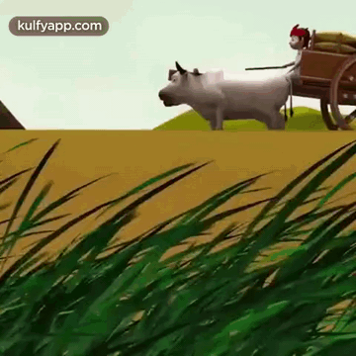
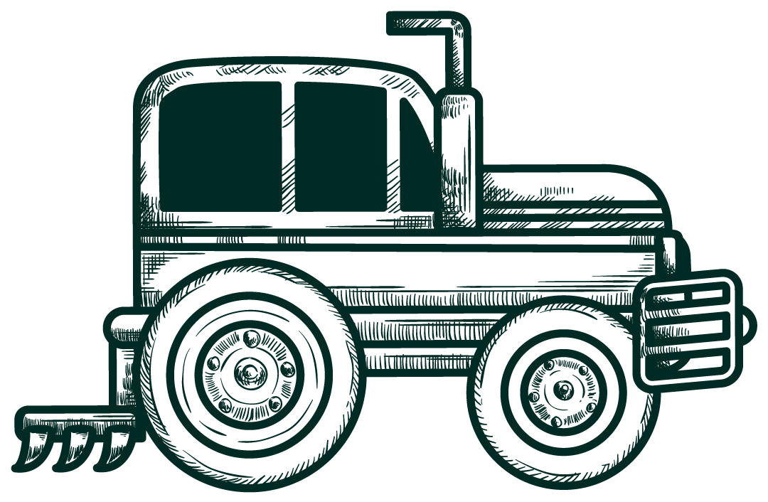
The Problem – Why Farmers Struggle?
🚨 72% of Indian farmers don’t have access to real-time expert advice.
❌ Google searches give conflicting results.
📞 Government helplines take days to respond.
💸 Bad decisions = Low yield = Financial loss.

Slide 6



Meet Agri Bot—the Smart Farming Assistant
01

Slide 7
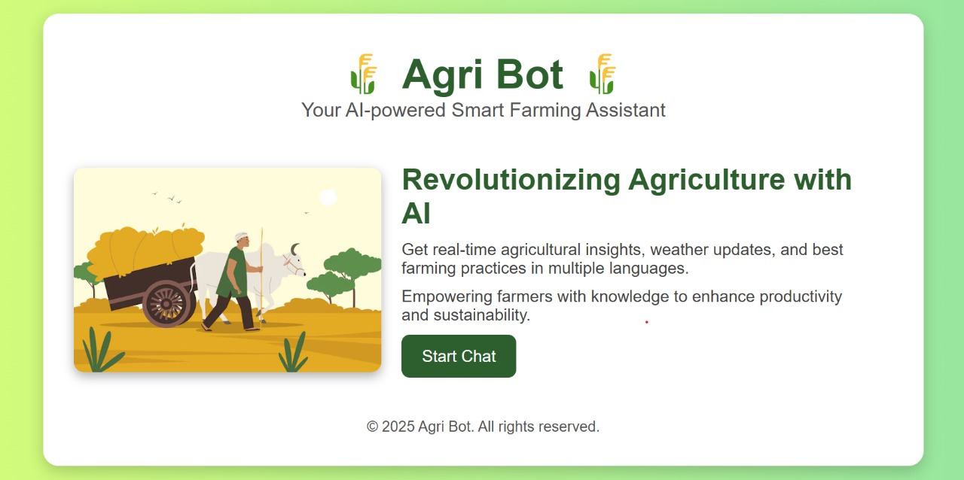

AGRI BOT
Get real-time agricultural insights, weather updates, and best farming practices in multiple languages. Empowering farmers with knowledge to enhance productivity and sustainability.

Slide 8

Features
🌾 AI-powered chatbot for farmers.
🤖 provides Answers in different regional language
⚡ Backed by GOOGLE’S GEMINI AI – Superfast & Reliable.
🔎 Pulls data from Wikipedia, Research Papers, and Web Searches.

Slide 9
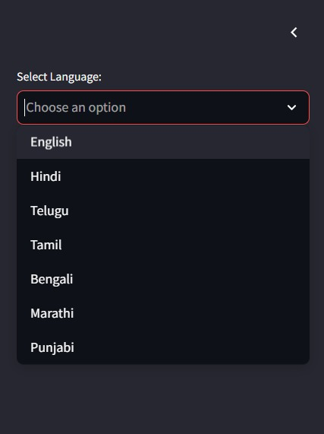
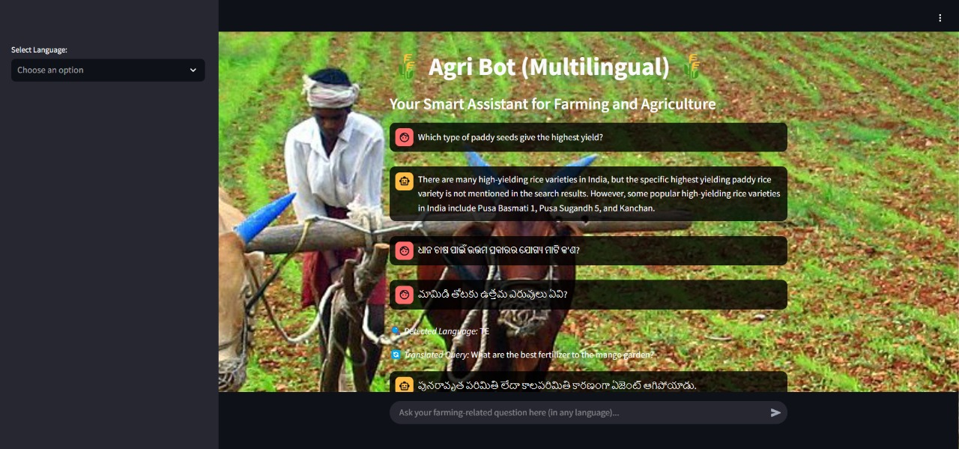
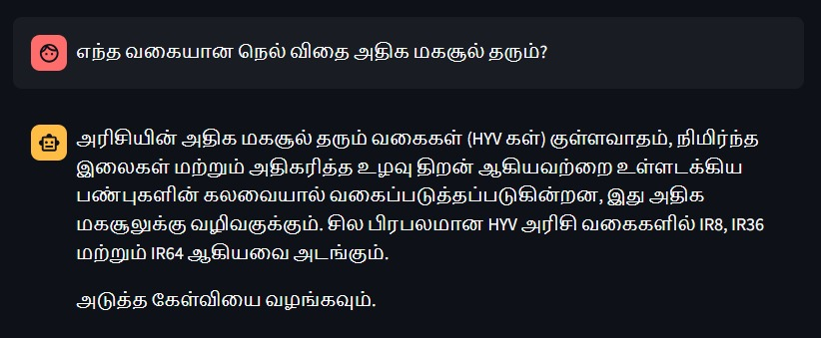

SCREEN GRABS OF AGRI BOT

Slide 10
Technical Overview – How Agri Bot Works?
Memory & Context Handling
Retrieval-Augmented Generation (RAG)
Interactive Chat UI
Built with Streamlit for real-time conversation
Uses LangChain to store past conversations
Fetches data from Wikipedia, Arxiv, DuckDuckGo
AI Model – GEMINI AI
Vector Database FACEBOOK AI SIMILARITY SEARCH (FAISS)
Superfast, accurate, and fine-tuned for agriculture
Stores common queries & retrieves relevant info

Slide 11
Agri Bot System Architecture – The Tech Stack
🖥️ Frontend: Streamlit – Lightweight & user-friendly interface
🧠 Memory: LangChain’s ConversationBufferMemory – Stores past chats
📡 Retrieval: Wikipedia API, Arxiv API, DuckDuckGo Search API
🧠 AI Processing: Gemini AI – Smart, context-aware responses
📊 Vector Database: FAISS – Quick knowledge retrieval for efficiency
🔌 Custom Actions: Fetches real-time weather updates & market prices

Slide 12
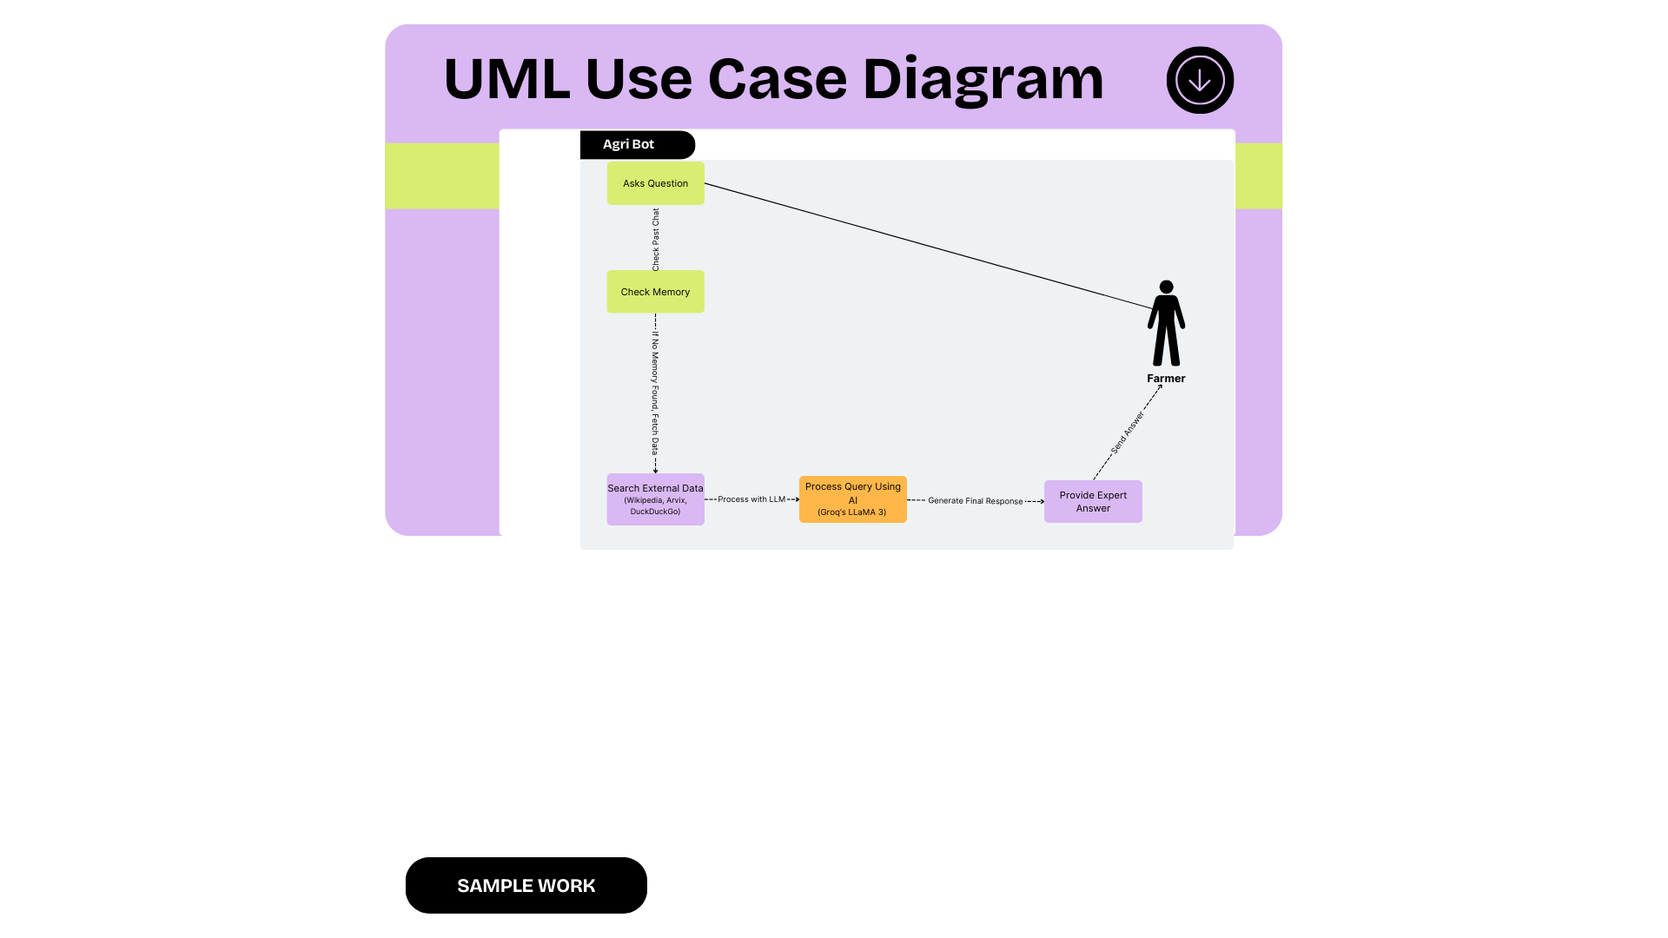

Slide 13


Slide 14
What Makes Agri Bot Unique?
✅ More than just a chatbot – It retrieves, thinks, and generates real answers.
🔎 Live Data Fetching – Wikipedia, Arxiv, DuckDuckGo for real-time updates.
🧠 Memory Retention – Remembers past queries, unlike traditional chatbots.
🌏 Multilingual Language Support – Helps farmers in their local language.
⚡ Superfast AI (Gemini AI) – Real-time, fact-based responses.

Slide 15
Potential Customers & Market Opportunities
Government Portals & Schemes – Integration with agriculture ministry platforms, enabling real-time AI advisory, funded by the government.
B2B Partnerships with Agritech Startups – AI chatbot integration into farming apps, e-commerce platforms, & digital advisory services.
Personalized Advisory for Farmers – Premium AI-driven recommendations for crop management, disease detection, and weather predictions.
Upskilling & Training Services – AI-based digital learning programs for farmers to improve productivity & modern farming techniques.

Slide 16


Slide 17
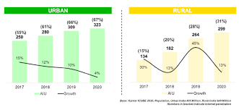

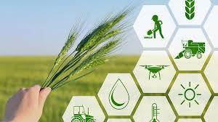
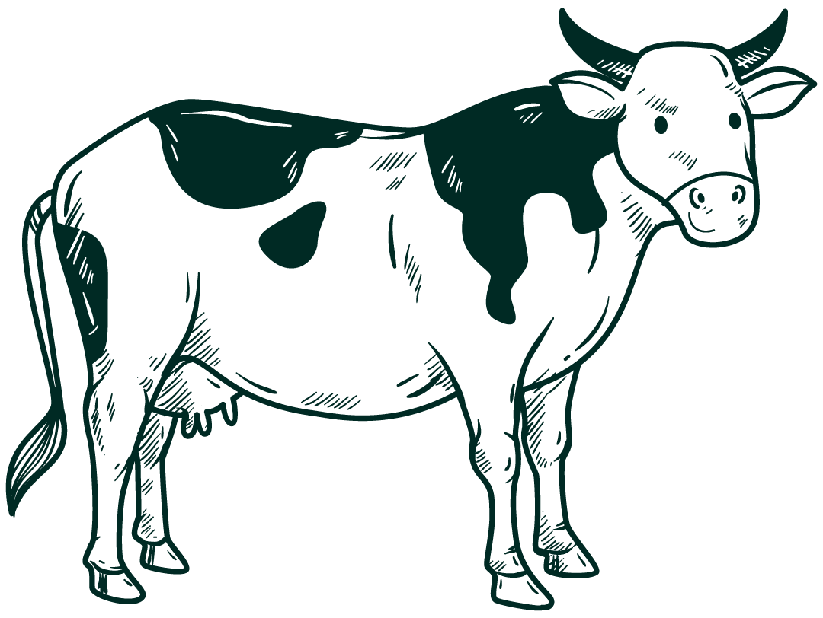
WHY NOW? - THE PERFECT TIMING!
🔥 AI Adoption is at an All-Time High.
🌾 Agritech Industry is Booming.
📱 Internet Penetration in Rural Areas is Rising.

Slide 18

Future scope
Expand Regional Language Support – Bengali, Urdu, Punjabi & more.
Voice-Based Chatbot – Helping farmers who can’t type.
AI-Powered Crop Disease Detection – Upload an image, get instant diagnosis.
Partnerships with Agricultural Universities – Real-world pilot testing.
Scaling Beyond India – AI advisory for global farming communities.

Slide 19
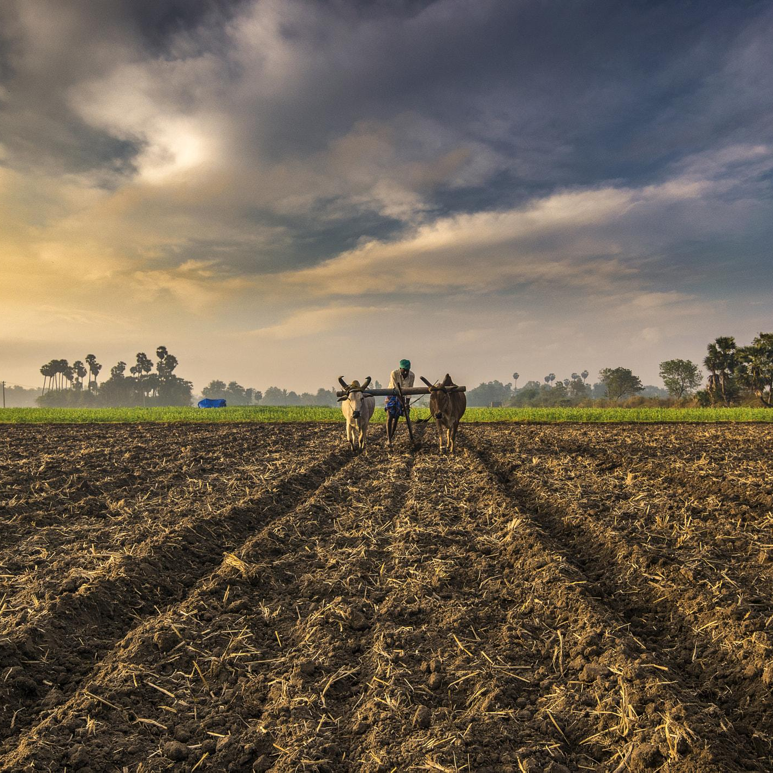

Final Thoughts – Why This Matters?
1.2 Billion Farmers Need Smarter Solutions.
AI + Farming = The Future of Agriculture.
Agri Bot Can Transform Rural Communities.
We’re Just Getting Started – Let’s Build the Future!

Slide 20
Thanks!
Please keep this slide as attribution

